Slide 1
Employee Attrition
Identifying the key reasons for attrition, creating actionable insights, and presenting them through a dashboard.

Slide 2
Data Insight
Employees are spread across different departments and locations.
Some departments have more exits than others.(e.g. Finance, Marketing)
Most employees who left had lower engagement.
Newer employees (short tenure) are more likely to leave.(e.g. Job_Level)
Younger and older employees show more exits compared to mid-aged groups.
Attrition is highest for entry-level employees at Job Level 1 when older individuals (>46) are hired, and for senior employees (>36) at Job Level 5
Mid-level roles (Job Levels 2–4) experience relatively stable retention.

Slide 3
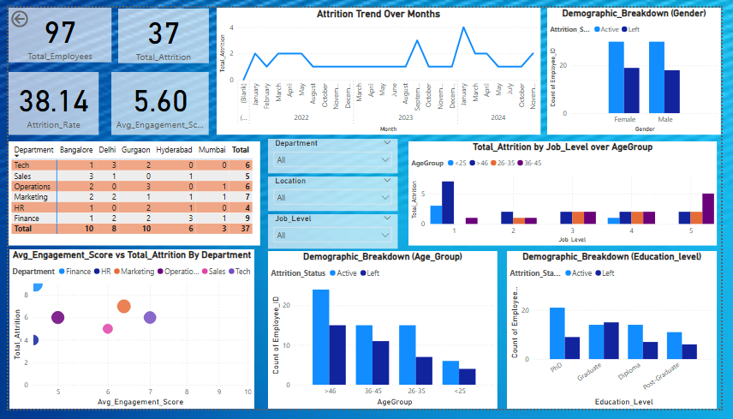

Slide 4
Recommendation
Focus on departments with higher attrition (e.g., Finance, Marketing)
Increase engagement activities (team bonding, feedback sessions, recognition)
Provide extra support for new joiners in the first 2–3 years
Offer flexible policies and wellness programs for younger and older employees
Provide targeted support for older hires at entry-level (Job Level 1) through mentorship, tailored onboarding, and role alignment

Slide 5
Implementation Plan
Run department-level surveys and career workshops to identify stress points and offer tailored growth opportunities.
Create a quarterly “Employee Connect Calendar” with planned events, recognition ceremonies, and open feedback forums.
Implement a structured buddy/mentorship program and regular check-ins during the first 24 months.
Build clear career growth and learning pathways.
Introduce hybrid work, health camps, and skill-upskilling initiatives to balance both flexibility and career growth.

